Slide 1

Introduction to Oil and Gas Allocation
Thomas Manuel Ortiz, Ph.D., P.E.
July 31, 2018

Slide 2



Welcome to The Doughmain, a bakery...
Jack
Barb
Raul
where the only product is sourdough bread

Slide 3
How Should We Calculate The Bakers’ Revenue Shares?
Equal?
Seniority?
Loaves baked per day?
Customer compliments received per month?
Baker | Years of Service | Loaves Per Day | Compliments Per Month
Jack | 5 | 10 | 40
Barb | 10 | 50 | 10
Raul | 15 | 30 | 20
There is no right or wrong answer!

Slide 4
Completeness and Consistency are Critical Elements
An allocation system must fully capture asset value
A single, consistent methodology must be used
Completeness and consistency lead to equitability
July 2018 | Jack | Barb | Raul | Total
Allocation Factor | 0.2895 | 0.3684 | 0.3421 | 1.0000
Loaves Sold At $3 Each |  |  |  | 1820
Revenue ($) | 1580.53 | 2011.58 | 1867.89 | 5460.00
Allocation Basis: (1/3) x Years of Service + (1/3) x Loaves Baked Per Day
+ (1/3) x Compliments Received Per Month

Slide 5
Let’s Have a Closer Look at This Allocation
 | Years | Loaves | Compliments | Allocation Basis | Allocation Factor | Revenue Share
Jack | 5 | 10 | 40 | 18.3333 | 0.2895 | 1580.53
Barb | 10 | 50 | 10 | 23.3333 | 0.3684 | 2011.58
Raul | 15 | 30 | 20 | 21.6667 | 0.3421 | 1867.89
Total |  |  |  | 63.3333 | 1.0000 | 5460.00
July 31, 2018
Loaves Sold | 1820 |  | Assumes 70 loaves sold per day and the bakery is open Mon-Sat
Price Per Loaf ($) | 3.00
Revenue ($) | 5460.00
For Barb, as an example: Allocation Basis = (10/3) + (50/3) + (10/3) = 23.3333
Allocation Factor = 23.3333/63.3333 = 0.3684
Revenue Share = 0.3684 x $5460 = $2011.58
Is this allocation complete? Consistent? Equitable?

Slide 6
Valuation of Oil and Gas is Complicated
Quantity
Oil shrinkage due to flash gas
Gas volume changes due to pressure base
Quality
Oil gravity
Oil BS&W content
Gas heating value
Gas composition
We can typically correct quantity issues by reporting volumes at standard conditions
Quality issues must often be explicitly addressed in an allocation methodology

Slide 7
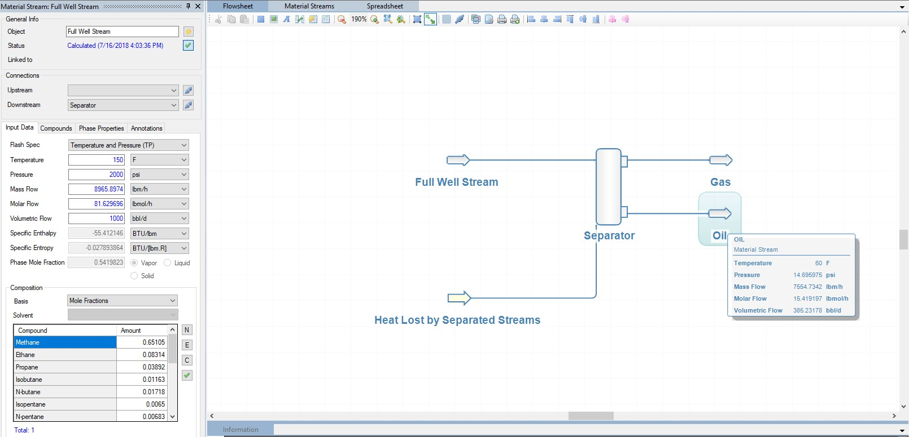
Example of Quantity Correction: Flashing of Crude Oil
This multiphase well stream flow of 1000 bpd at 150 F & 2000 psia
would yield only 365 bpd of oil in a hypothetical* single stage of separation at stock tank conditions. What happened?
* This is an overly simplified facility representation used to illustrate how much oil can shrink after high pressure drops

Slide 8
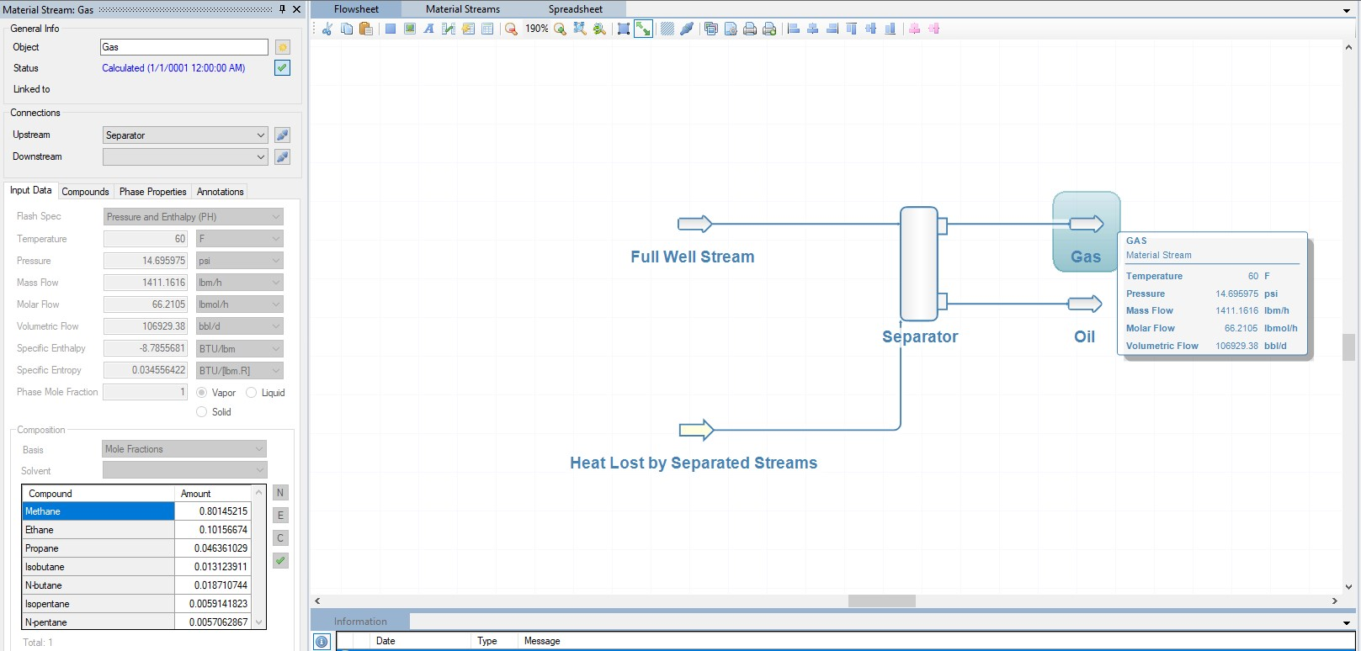
Example of Quantity Correction: Flashing of Crude Oil
The remainder of the fluid is evolved as flash gas
Gas Flow = 600 Mcf/d
(1 ft³ = 0.17811 bbl)

Slide 9
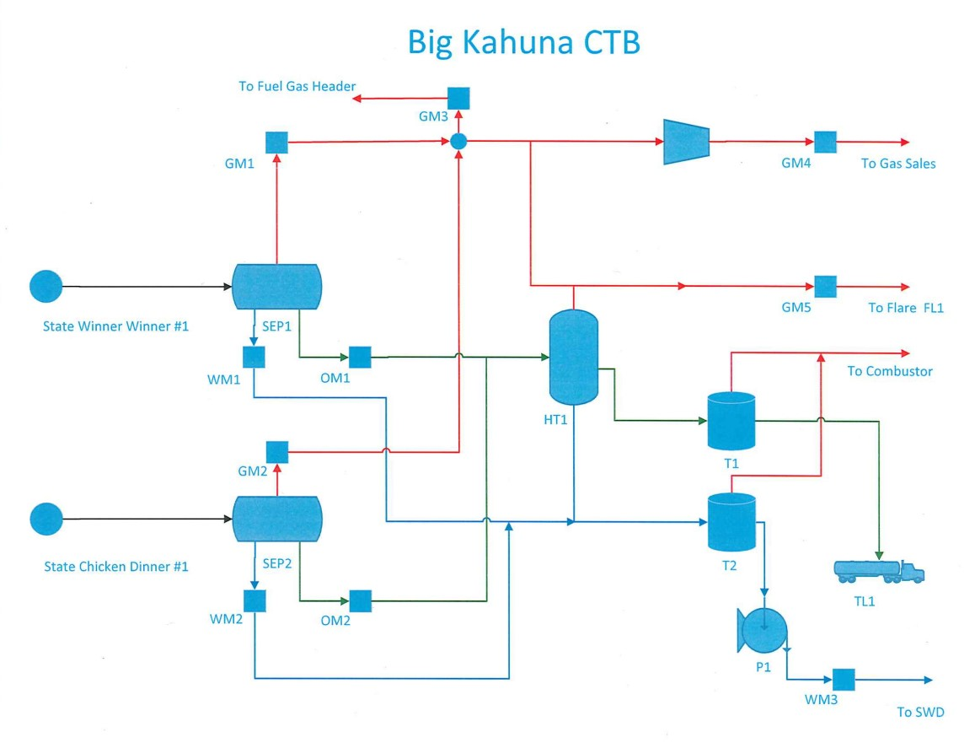
Let’s Allocate!

Slide 10
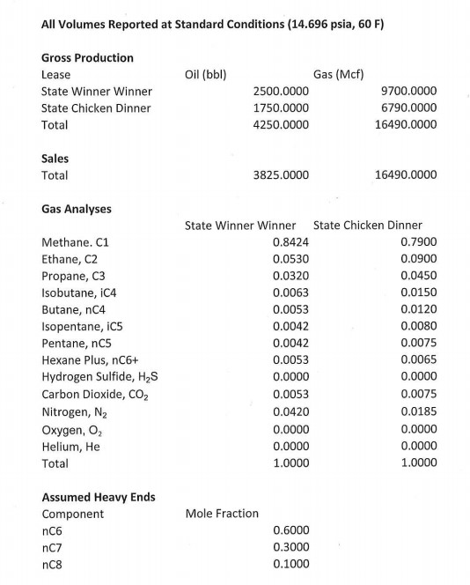
Begin by Assembling Necessary Input Data
Verify!
From production reports
From gas sample lab reports
Per GPA Standard 2216

Slide 11
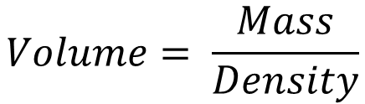
Oil is Allocated by Volume
Why not by mass? Actually, we are allocating oil by mass, under the assumption that, as a liquid, oil is incompressible—meaning that its density does not change much with pressure.
$$Volume= \frac{Mass}{Density}$$
 | State Winner Winner |  |  |  |  | State Chicken Dinner
Sales | Beginning Inventory | Gross Production | Allocation Factor | Allocated Volume | Ending Inventory | Beginning Inventory | Gross Production | Allocation Factor | Allocated Volume | Ending Inventory
1000 | 0 | 1250 | 0.4167 | 416.6667 | 833.3333 | 0 | 1750 | 0.5833 | 583.3333 | 1166.6667
0 | 833.3333 | 1110 | 0.4091 | 0 | 1943.3333 | 1166.6667 | 1640 | 0.5909 | 0 | 2806.6667
1800 | 1943.3333 | 0 | 0.3060 | 550.8661 | 1392.4672 | 2806.6667 | 1600 | 0.6940 | 1249.1340 | 3157.5328
3825 | 1392.4672 | 2500 | 0.4423 | 1691.896 | 2200.5709 | 3157.5328 | 1750 | 0.5577 | 2133.1040 | 2774.4291
All volumes in bbl

Slide 12
The Available for Sale Method
Allocation Basis: Beginning Inventory + Gross Production
 | State Winner Winner |  |  |  |  | State Chicken Dinner
Sales | Beginning Inventory | Gross Production | Allocation Factor | Allocated Volume | Ending Inventory | Beginning Inventory | Gross Production | Allocation Factor | Allocated Volume | Ending Inventory
3825 | 1392.4672 | 2500 | 0.4423 | 1691.896 | 2200.5709 | 3157.5328 | 1750 | 0.5577 | 2133.1040 | 2774.4291
$${Allocation Factor}_{State Winner Winner}= \frac{1392.4672+2500}{\left(1392.4672+2500\right)+ \left(3157.5328+1750\right)}=0.4423$$
$${Allocated Volume}_{State Winner Winner}=0.4423×3825=1691.896$$
$${Ending Inventory}_{State Winner Winner}=1392.4672+2500−1691.896=2200.5709$$
Available for Sale is the method stipulated in API MPMS Ch. 20.1 for use in oil allocation

Slide 13
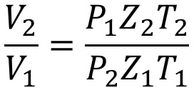
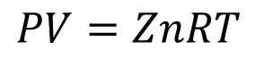
Gas is Allocated by Mass (Rich) or Energy (Lean)
Processed gas, i.e. gas that is too rich to be sold as pipeline gas and must have liquids (NGLs) removed, is allocated by mass, a.k.a. molecular balance, a.k.a. component. Non-processed gas (and residue gas) are both allocated by energy. NOTE: We never approve gas allocation by volume.
Unlike oil, gas is a compressible fluid, which means the volume of a gas is highly dependent on its pressure. But simply correcting gas volumes for pressure isn’t enough.
$$PV=ZnRT$$
V volume (ft³)
P pressure (psia)
Z compressibility factor (dimensionless)
n moles (lbmol)
R universal gas constant = 10.7316 ft³-psia/lbmol-R
T temperature (R)
$$\frac{V_{2}}{V_{1}}=\frac{P_{1}Z_{2}T_{2}}{P_{2}Z_{1}T_{1}}$$

Slide 14
Gas Energy and Value Both Depend on Composition
Compound | Heating Value** (Btu/ft3) | Price | Date
Methane, C1 | 1010.0 | $2.90/MMBtu *** | 07/09/2018
Ethane, C2 | 1769.7 | $0.3905/gal | 07/09/2018
Propane, C3 | 2516.1 | $0.952/gal | 07/06/2018
Isobutane, iC4 | 3251.9 | $1.2046/gal | 07/09/2018
Normal Butane, nC4 | 3262.3 | $1.1767/gal | 07/09/2018
Isopentane, iC5 | 4000.9 | $1.5586/gal **** | 07/09/2018
Normal Pentane, nC5 | 4008.7 | $1.5586/gal **** | 07/09/2018
Hexane Plus*, C6+ | 5129.22 | $1.5586/gal **** | 07/09/2018
* Recall that we assume the composition of hexane plus to be equal to 60% nC6 (hexane), 30% nC7 (heptane) and 10% nC8 (octane) per GPA Standard 2216.
*** Pipeline quality natural gas is predominantly composed of methane. The quoted price is for NYMEX natural gas.
** From GPA Standard 2145
**** C5+ is priced and sold as “natural gasoline”

Slide 15
Why Don’t We Allocate NGLs by Energy Balance?
The prices of NGL components vary continuously, not only in absolute terms, but also with respect to one another. On the other hand, NGL component energy content values are constant, physical properties.
 | Energy Content (Btu/ft³) | Price ($/gal)
Ethane, C2 | 1769.7 | 0.3905
Normal Butane, nC4 | 3262.3 | 1.1767
 | Ratio
Normal Butane/Ethane | 1.84 | 3.01
Butane is currently worth 3x as much as ethane, but only has 84% more energy.
$$Let Lease 1 produce 1000 gal C2, and Lease 2 produce 1000 gal nC4$$
$$By energy:A_{L1}=\frac{1000×1769.7}{\left(1000×1769.7\right)+\left(1000×3262.3\right)}=0.3517$$
$$By value:A_{L1}=\frac{1000×0.3905}{\left(1000×0.3905\right)+\left(1000×1.1767\right)}=0.2492$$

Slide 16
Calculation of Gas Heating Value from Composition
Compound | Mole Fraction | Compound Heating Value | Contribution to Total
Methane, C1 | 0.7900 | 1010.0 | 797.9000
Ethane, C2 | 0.0900 | 1769.7 | 159.273
Propane, C3 | 0.0450 | 2516.1 | 113.2245
Isobutane, iC4 | 0.0150 | 3251.9 | 48.7785
Normal Butane, nC4 | 0.0120 | 3262.3 | 39.1476
Isopentane, iC5 | 0.0080 | 4000.9 | 32.0072
Normal Pentane, nC5 | 0.0075 | 4008.7 | 30.0653
Hexane Plus, C6+ | 0.0065 | 5129.22 | 33.3399
Hydrogen Sulfide, H2S | 0 | 637.1 | 0
Carbon Dioxide, CO2 | 0.0075 | 0 | 0
Nitrogen, N2 | 0.0185 | 0 | 0
Oxygen, O2 | 0 | 0 | 0
Helium, He | 0 | 0 | 0
Total | 1.0000 |  | 1253.7360
X
=
Heating values in Btu/ft³

Slide 17


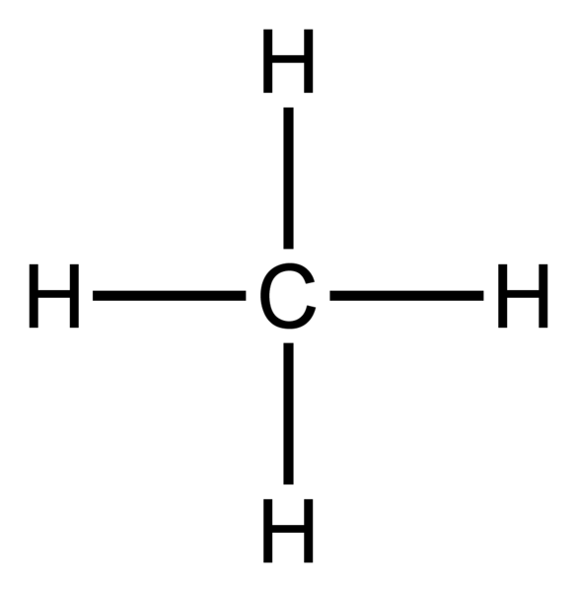
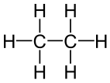
What’s a Mole Fraction?
Avogadro’s Law: The volume of a gas is directly proportional to the number of gas molecules contained in that volume
N_{A} ≈ 6.02 x 10²³ molecules = 1 mole
2 Mcf =
Mole Fractions
C1 | 0.5
C2 | 0.5
1 Mcf +
1 Mcf
For an ideal gas, mole fractions are equal to volume fractions

Slide 18
Chemicals React on a Mole (a.k.a. Mass) Basis
$${Combustion of Natural Gas: CH}_{4}+{2O}_{2}={CO}_{2}+{2H}_{2}O$$
1 Mole
2 Moles
1 Mole
2 Moles
When we need to calculate properties of gas mixtures which contain many different compounds, we use mole fractions to compute the relative contribution of each compound in the mixture.
Mass is related to moles by the molecular weight of a substance
Compound | Molecular Weight (lbm/lbmol)
C | 12.011
H | 1.008
O | 15.999

Slide 19
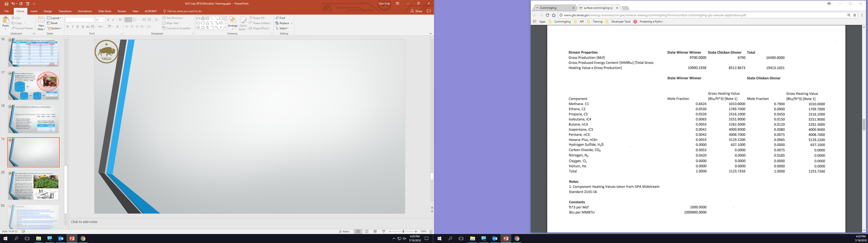
Heating Values for Our Two Example Leases
Note 1: Values taken from GPA Standard 2145

Slide 20

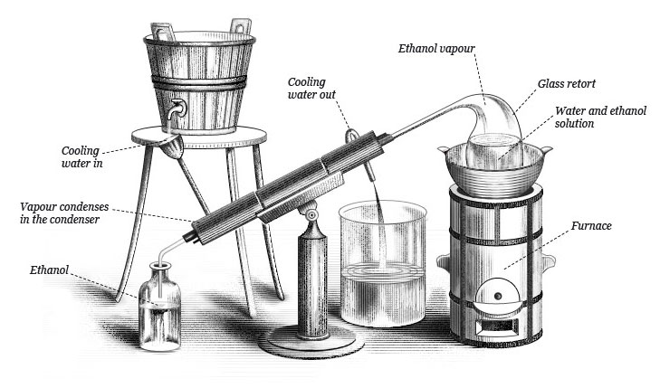
How Much NGL Can We Get From A Gas Stream?
NGLs can be condensed out of a raw natural gas stream the same way water can be condensed out of the air on a cool night: Chill it.
The maximum amount of an NGL that is available from a particular gas stream is equal to the number of moles of that component in the stream. If the gas were chilled to the dew point of that component, under perfect conditions, all of the component would condense out. We call this amount the number of theoretical gallons of that component available in the gas.

Slide 21
GPA Standard 2145 Includes “Condensation Tables”
Compound | Volume of Ideal Gas Per Gallon of Liquid (ft³)
Ethane, C2 | 37.4880
Propane, C3 | 36.3910
Isobutane, iC4 | 30.6370
Normal Butane, nC4 | 31.8010
Isopentane, iC5 | 27.4140
Normal Pentane, nC5 | 27.6580
Hexane Plus, nC6+ | 23.1040
Imagine that you poured a gallon of each one of these compounds into a container. The volume of gas shown is the amount, at 60 F and 14.696 psia, that you would obtain for each component if you boiled all of the liquid.
For pure ethane at 14.696 psia and 60 F
$$\frac{1}{37.4880 {{ft}^{3}}/{gal}}×\frac{1000 {ft}^{3}}{Mcf}×\frac{1}{0.9915}=26.9039 GPM (Gallons per Mcf)$$
Compressibility Factor (Z)

Slide 22
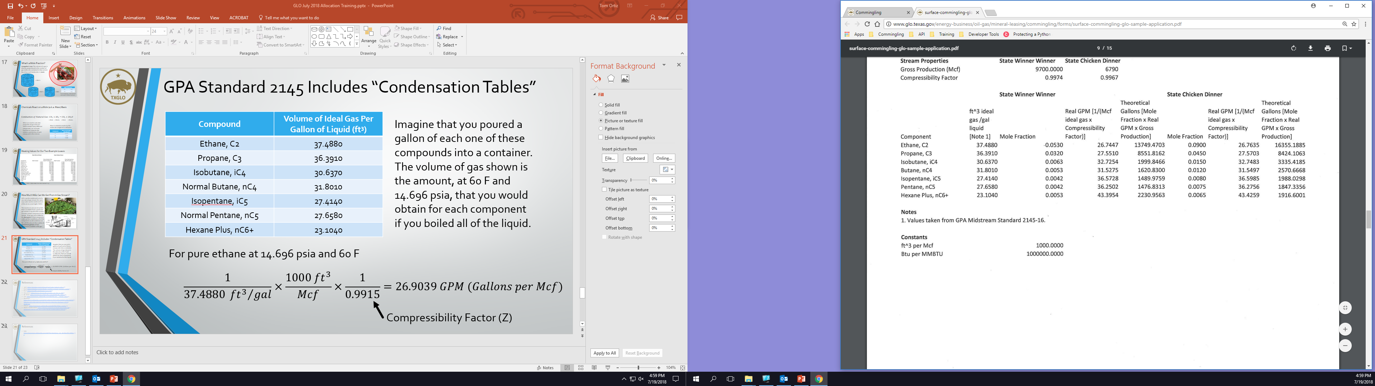
Theoretical Gallons for Our Two Example Leases
$26.7447 GPM ×0.053×9700 Mcf=13,749.4703 Theoretical Gallons$ C2
Note 1: Values taken from GPA Standard 2145

Slide 23
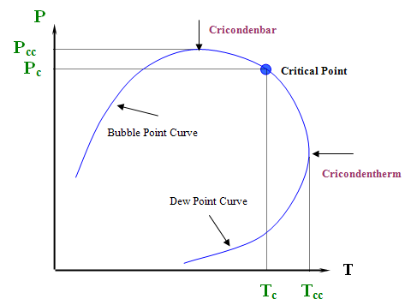
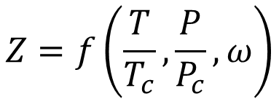
Compressibility Factor and Corresponding States
The Theory of Corresponding States posits that the thermodynamic properties of any fluid can be expressed as functions of the fluid state’s relative “distance” from the critical point.
All Liquid
All Vapor
We can predict the compressibility factor of a gas by constructing such a function.
$$Z=f\left(\frac{T}{T_{c}},\frac{P}{P_{c}}, ω\right)$$
T Temperature c Critical
P Pressure ω Acentric factor
Z Compressibility Factor

Slide 24

“Live” Supercritical Fluid Transition
A supercritical fluid is formally neither a liquid nor a vapor, but it can exhibit both “liquid-like” and “gas-like” behaviors.

Slide 25
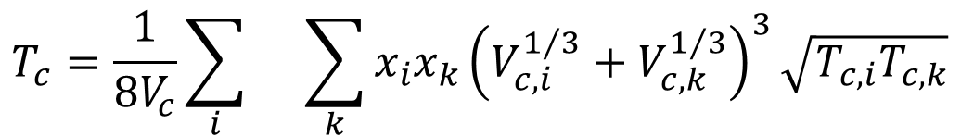
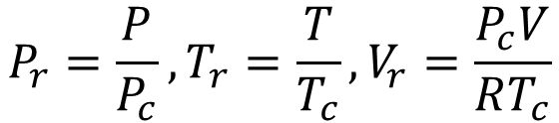
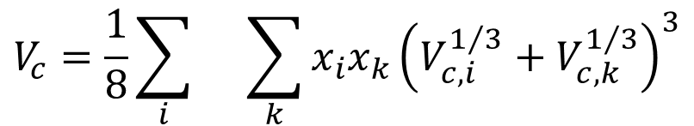
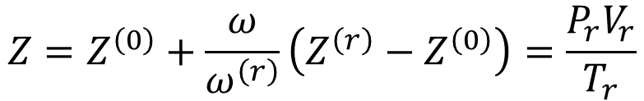
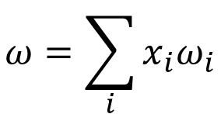
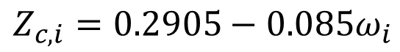
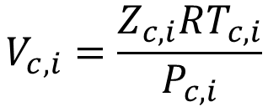
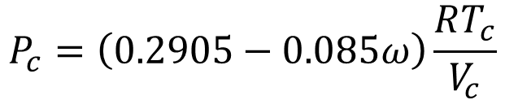
The Lee-Kesler Correlations
$$Z=Z^{\left(0\right)}+\frac{ω}{ω^{\left(r\right)}}\left(Z^{\left(r\right)}−Z^{\left(0\right)}\right)=\frac{P_{r}V_{r}}{T_{r}}$$
$$P_{r}=\frac{P}{P_{c}},T_{r}=\frac{T}{T_{c}},V_{r}=\frac{P_{c}V}{RT_{c}}$$
$$V_{c,i}=\frac{Z_{c,i}RT_{c,i}}{P_{c,i}}$$
$$ω=\sum_{i}{{x_{i}ω}_{i}}$$
$$Z_{c,i}=0.2905−0.085ω_{i}$$
$$V_{c}=\frac{1}{8}\sum_{i}{}\sum_{k}{x_{i}x_{k}{\left(V_{c,i}^{1/3}+V_{c,k}^{1/3}\right)}^{3}}$$
(0) Simple Fluid
(r) Reference Fluid
$$T_{c}=\frac{1}{8V_{c}}\sum_{i}{}\sum_{k}{x_{i}x_{k}{\left(V_{c,i}^{1/3}+V_{c,k}^{1/3}\right)}^{3}\sqrt{T_{c,i}T_{c,k}}}$$
$$P_{c}=\left(0.2905−0.085ω\right)\frac{RT_{c}}{V_{c}}$$
From: Lee, B. I. and Kesler, M. G. (1975), “A Generalized Thermodynamic Correlation Based on Three-Parameter Corresponding States”, AIChE Journal 21(3), pp 510-527.

Slide 26
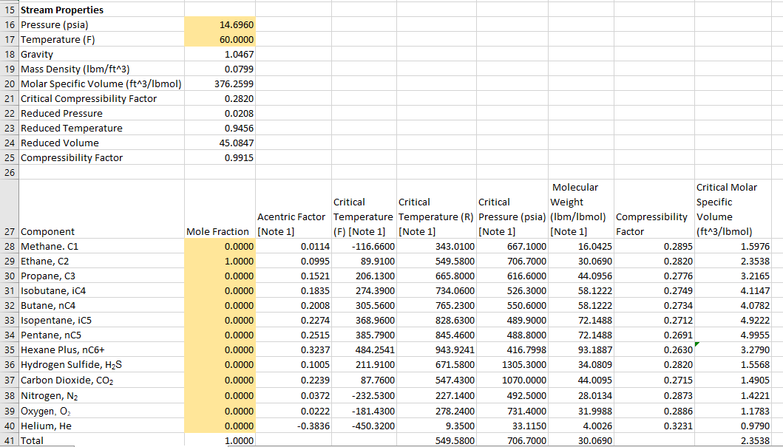
Lee-Kesler Requires Iterative Calculations

Slide 27
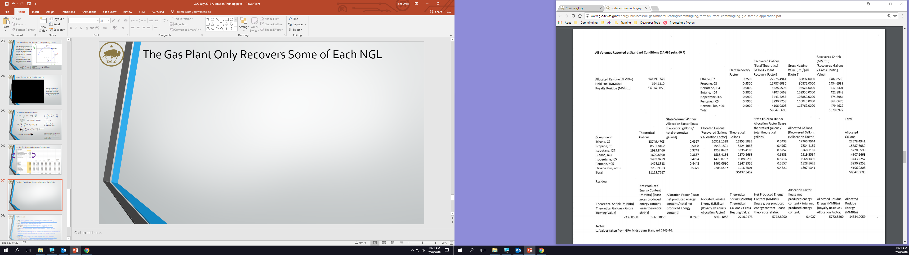
The Gas Plant Only Recovers Some of Each NGL
Physical limitations always exist due to mechanical and thermodynamic inefficiencies
However, the recovery factors listed in a gas plant settlement statement are typically agreed upon by contract in advance.
$C2 Shrink=0.7500×$ $\left(13,749.4703+16355.1885\right)×\frac{65,897Btu/gal}{1,000,000Btu/MMBtu}=1487.8550 MMBtu$
Note 1: Values from GPA Standard 2145

Slide 28
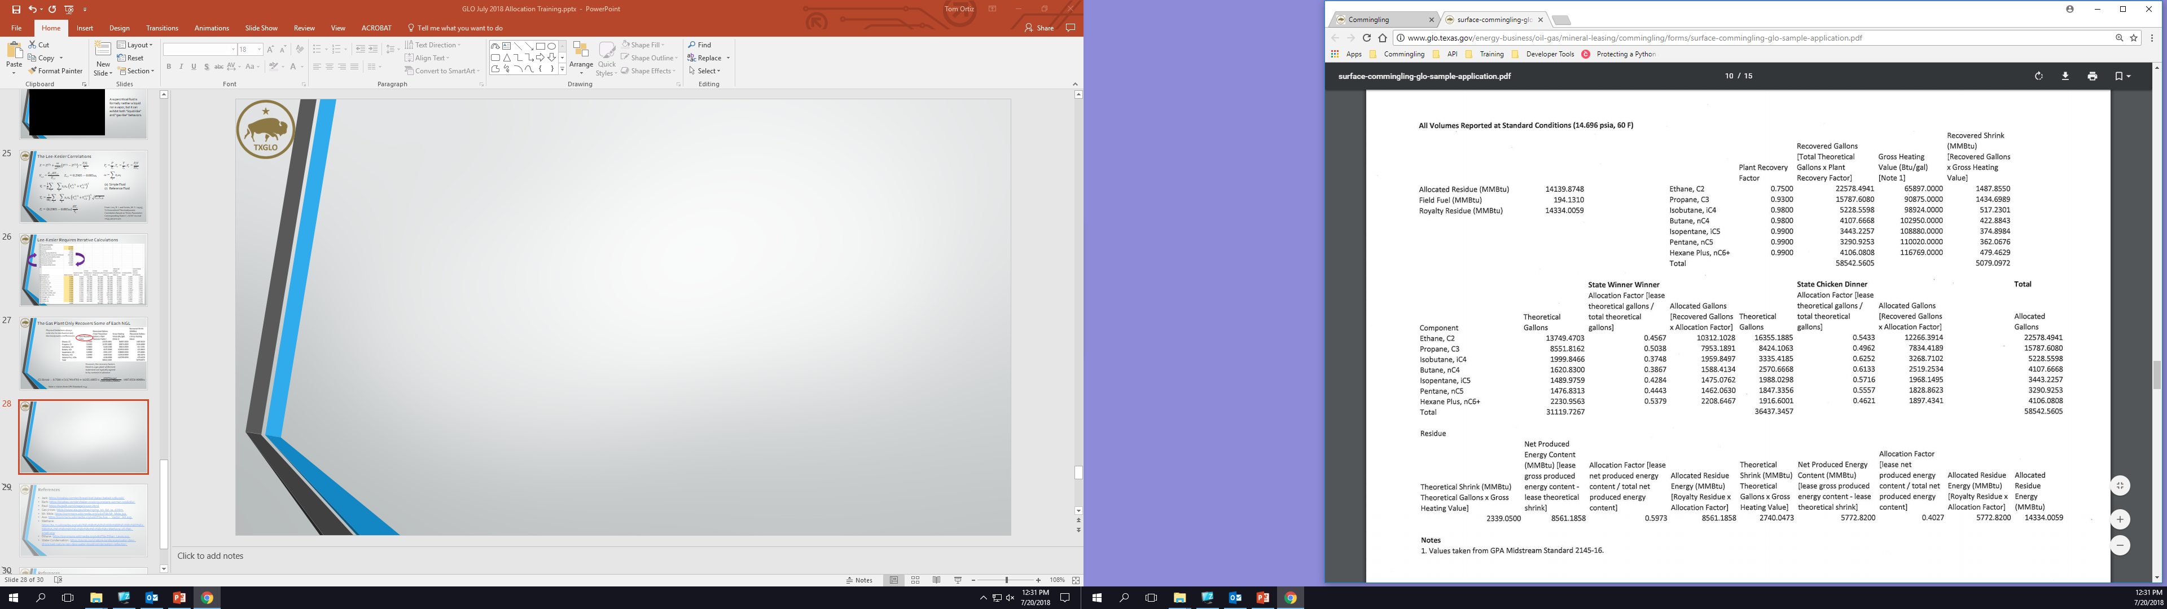
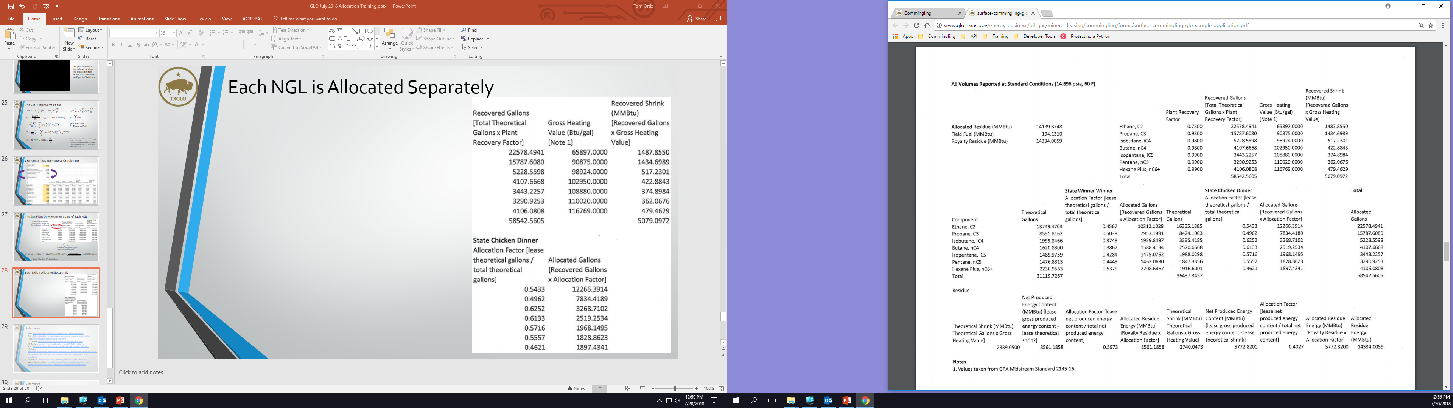
Each NGL is Allocated Separately
Theoretical Gallons
$$A_{nC6+, State Chicken Dinner}=\frac{1916.6001}{2230.9563+1916.6001}=0.4621$$
$$V_{nC6+, State Chicken Dinner}=0.4621×4106.0808=1897.4341$$
Recovered Gallons

Slide 29
Residue Gas is Allocated by Energy Balance
State Winner Winner | Volume (Mcf) | Allocated Gallons | Heating Value (Btu/ft³ or Btu/gal) | Energy (MMBtu)
Gross Production | 9700 |  | 1123.7356 | 10,900.2358
C2 Shrink |  | 10,312.1028 | 65,897 | 679.5366
C3 Shrink |  | 7953.1891 | 90,875 | 722.7461
iC4 Shrink |  | 1959.8497 | 98,924 | 193.8762
nC4 Shrink |  | 1588.4134 | 102,950 | 163.5272
iC5 Shrink |  | 1475.0762 | 108,880 | 160.6063
nC5 Shrink |  | 1462.0630 | 110,020 | 160.8562
C6+ Shrink |  | 2208.6467 | 116,769 | 257.9015
Residue |  |  |  | 8561.1858
-
-
-
-
-
-
-
=
$$A_{Residue, State Winner Winner}=\frac{8561.1858}{8561.1858+5772.8200}=0.5973$$
Total Residue from Gas Plant Settlement Statement
$$V_{Residue, State Winner Winner}=0.5973×14,334.0059=8561.1858$$

Slide 30
Final Allocation Results
 | State Winner Winner | State Chicken Dinner | Total
Ethane, C2 (gal) | 10,312.1028 | 12,266.3914 | 22,578.4941
Propane, C3 (gal) | 7953.1891 | 7834.4189 | 15,787.6080
Isobutane, iC4 (gal) | 1959.8497 | 3268.7102 | 5228.5598
Normal Butane, nC4 (gal) | 1588.4134 | 2519.2534 | 4107.6668
Isopentane, iC5 (gal) | 1475.0762 | 1968.1495 | 3443.2257
Normal Pentane, nC5 (gal) | 1462.0630 | 1828.8623 | 3290.9253
Hexane Plus, nC6+ (gal) | 2208.6467 | 1897.4341 | 4106.0808
Residue (MMBtu) | 8561.1858 | 5772.8200 | 14,334.0059
Remember: Totals must match plant settlement statement values! If they don’t, then audit for deductions or mathematical errors.

Slide 31
Questions?

Slide 32
References and Image Sources
Jack: https://pixabay.com/en/bread-loaf-baker-baked-1084016/
Barb: https://pixabay.com/en/baker-cooking-prepare-woman-1296062/
Raul: https://svgsilh.com/image/29205.html
Gas prices: https://www.eia.gov/dnav/ng/ng_pri_fut_s1_d.htm
Mr. Mole: https://commons.wikimedia.org/wiki/File:Mr_Mole.jpg
Axe: https://commons.wikimedia.org/wiki/File:Axe_-_Vector_Art.svg
Methane: https://te.m.wikipedia.org/wiki/%E0%B0%A6%E0%B0%B8%E0%B1%8D%E0%B0%A4%E0%B1%8D%E0%B0%B0%E0%B0%82:Methane-2D-flat-small.png
Ethane: https://commons.wikimedia.org/wiki/File:Ethan_Lewis.svg
Water Condensation: https://pixnio.com/nature-landscapes/water-dew-drops/wet-nature-rain-dew-water-liquid-condensation-reflection

Slide 33
References and Image Sources
Still: https://commons.wikimedia.org/wiki/File:Alambique_de_destilaci%C3%B3n.jpg
Multicomponent Phase Diagram: https://www.e-education.psu.edu/png520/m4_p3.html
Supercritical CO2: https://www.youtube.com/watch?v=GEr3NxsPTOA
Lee-Kesler Correlations: http://dns2.asia.edu.tw/~ysho/YSHO-English/1000%20CE/PDF/AIChE%20J21,%20510.pdf

